Slide 1


An Introduction to Convolutional Neural Networks Understanding the Basics
Dr. Anirban Dasgupta
Assistant Professor
Department of Electronics and Electrical Engineering
Indian Institute of Technology Guwahati
January 2025

Slide 2
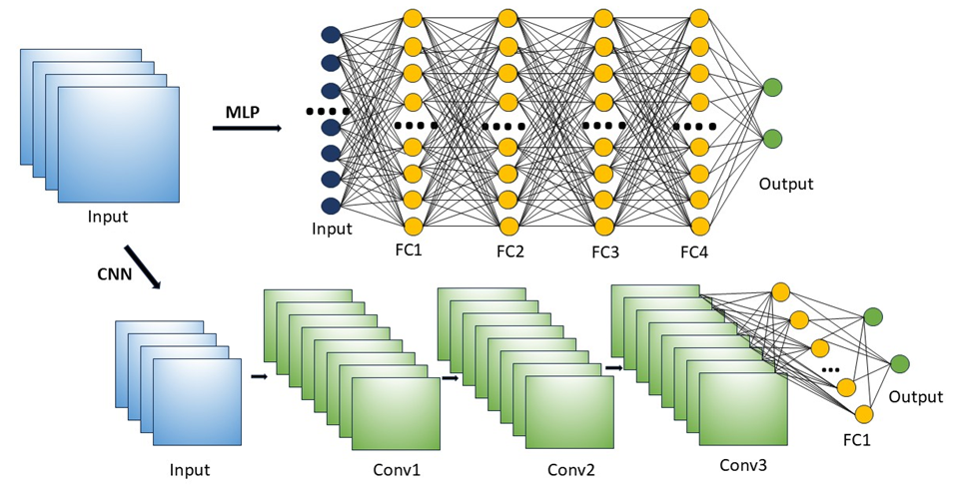
Basic Principles
Difference between MLP and CNN
MLP: Multi-layer perceptron
CNN: Convolutional Neural Network
FC: Fully Connected
Conv: Convolution

Slide 3
Components of CNN
Convolutional Layers
Pooling Layers
Fully Connected Layers
Activation Layers
Custom Layers

Slide 4
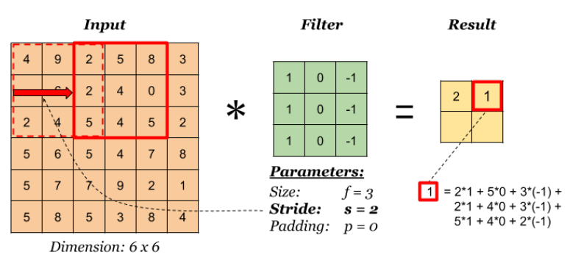

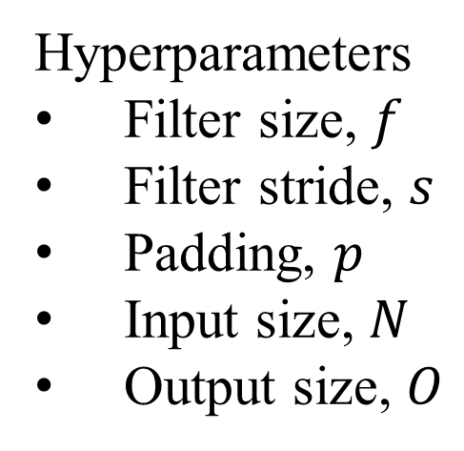
Convolutional Layers
Hyperparameters
Filter size, $f$
Filter stride, $s$
Padding, $p$
Input size, $N$
Output size, $O$

Slide 5
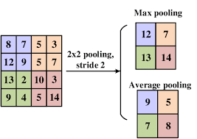
Pooling Layers
Reducing the risk of overfitting
Decreasing the computational load in training
Hyperparameters
Filter size
Filter stride

Slide 6
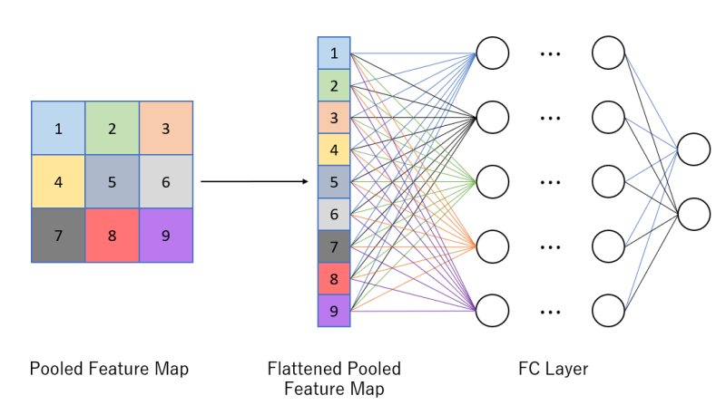
Fully Connected Layers
appear towards the end of the CNN
also known as dense layers
fully connected layers flatten the input into a one-dimensional vector and connect each neuron to every neuron in the previous layer

Slide 7
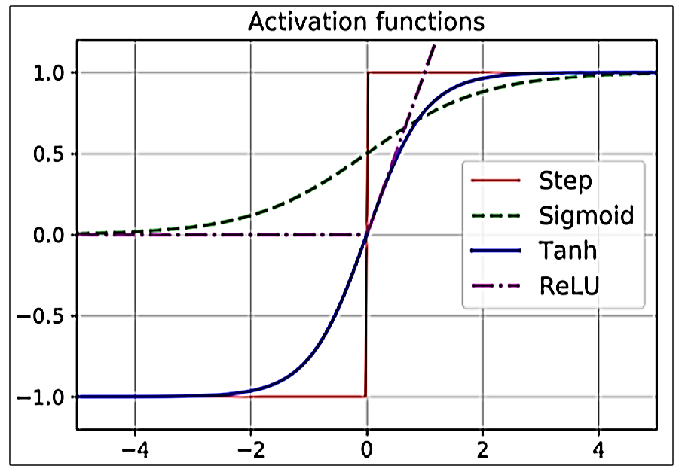
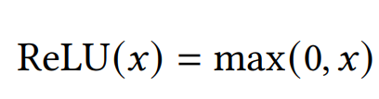
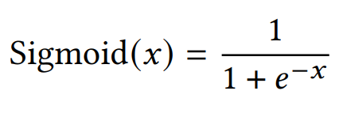
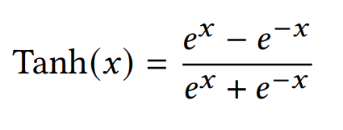
Activation Layers

Slide 8
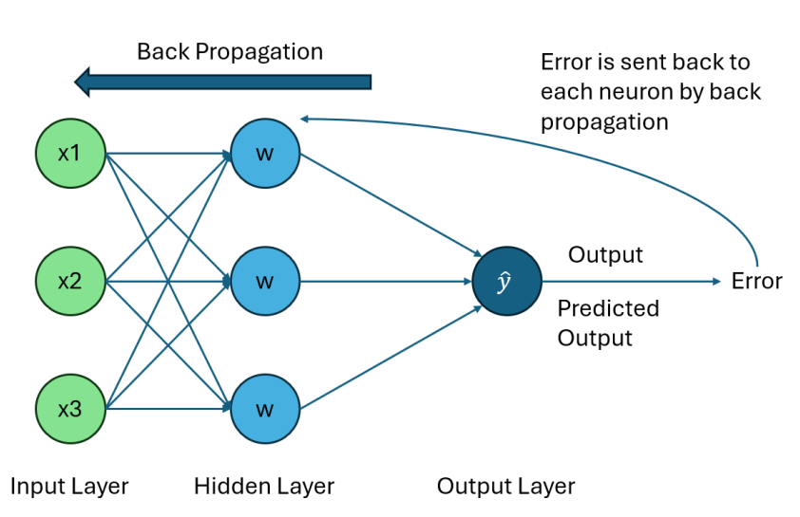
Backpropagation

Slide 9

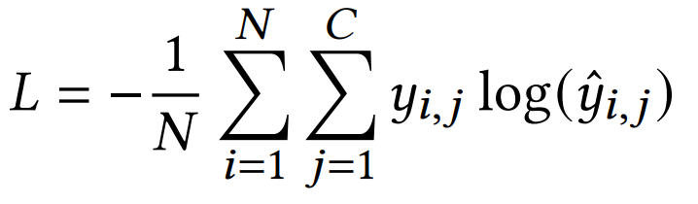
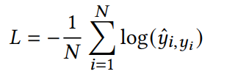
Various Loss Functions
Binary Cross-Entropy Loss
$y$ is the true label (0 or 1), and $\hat{y}$ is the predicted probability
Cross-Entropy Loss
$y_{i,j}$ is the true label for class $j$ of sample $i$, ${\hat{y}}_{i,j}$ is the predicted probability for class $j$ of sample $i$
Sparse Categorical Cross-Entropy Loss
one-hot encoded labels

Slide 10
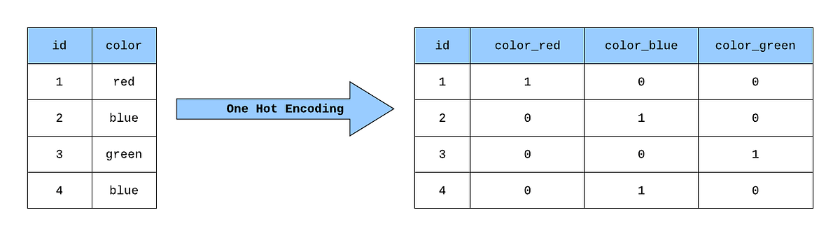
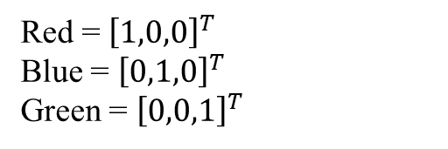
One-hot Encoding
Red = 0
Blue = 1
Green = 2
Red = ${\left[1,0,0\right]}^{T}$
Blue = ${\left[0,1,0\right]}^{T}$
Green = ${\left[0,0,1\right]}^{T}$

Slide 11
Hyperparameters
Batch Size
Batch size determines the number of training examples used to update the model’s weights in each iteration.
A smaller batch size typically leads to noisier updates but faster convergence, while larger batch sizes provide more stable updates but require more memory and computation.
Epoch
The number of epochs specifies how many times the entire training dataset is passed through the model during training.
Setting too few epochs may lead to underfitting, where the model doesn’t learn enough from the data, while too many epochs can result in overfitting, where the model learns noise instead of the underlying patterns.

Slide 12
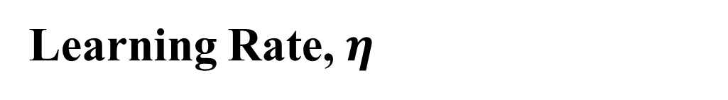
Hyperparameters
Validation Split
Validation split determines the proportion of the training dataset set aside for validating the model’s performance during training, allowing for the assessment of generalization without using the test set.
Learning Rate, $η$
The learning rate controls the size of the steps taken during the optimization process, influencing how quickly or slowly a model converges to the minimum of the loss function.
A too high learning rate can lead to overshooting the optimal solution, while a too low rate may result in slow convergence or getting stuck in local minima.

Slide 13
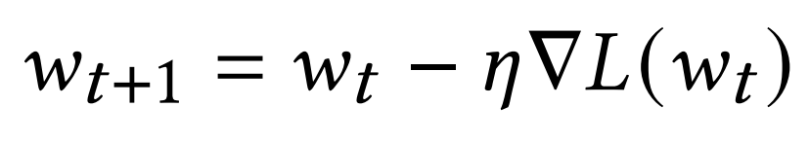


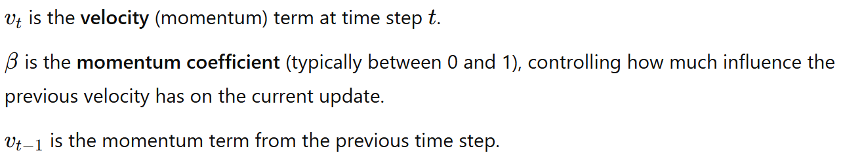
Optimizers
An optimizer is an algorithm used to adjust the weights and biases of a neural network during training to minimize the loss function
Gradient Descent (GD)
Gradient Descent (GD) – whole dataset
Stochastic Gradient Descent (SGD) – single example
Mini Batch Gradient Descent (MBGD) – a small batch
Stochastic Gradient Descent (SGD) with Momentum

Slide 14
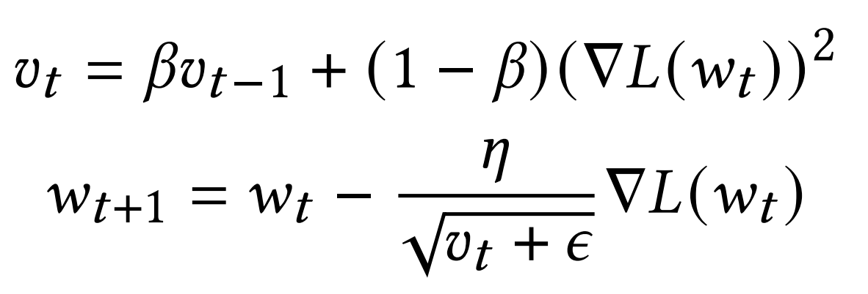
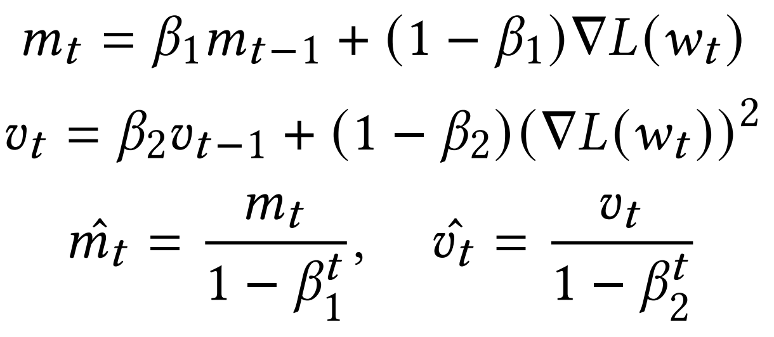
Optimizers
Root Mean Square Propagation (RMSprop)
Adaptive Moment Estimation (Adam)

Slide 15
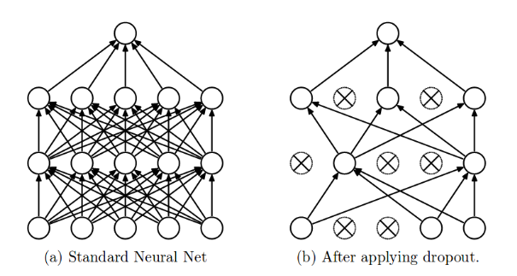
Dropout Layers

Slide 16
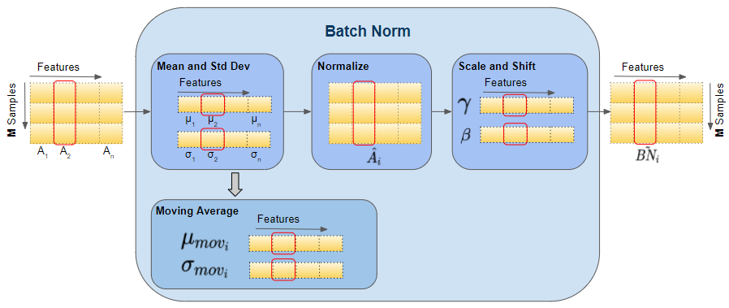
Batch Normalization Layers

Slide 17
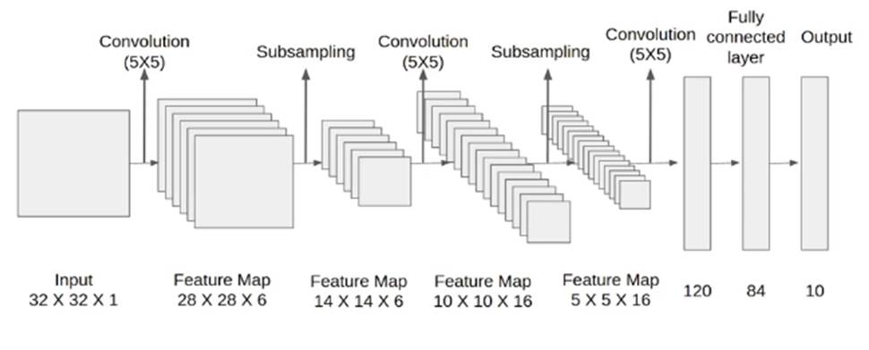
LeNet

Slide 18
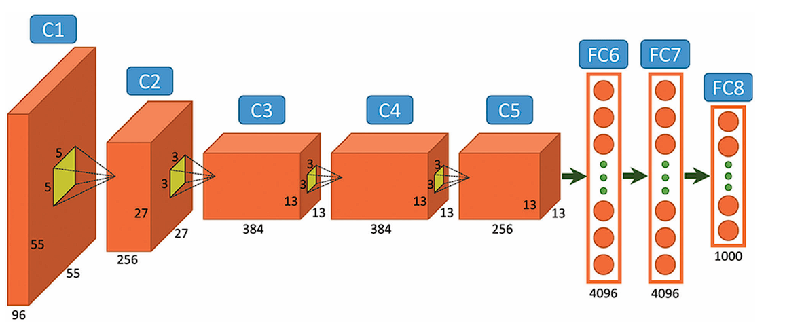
Alexnet

Slide 19
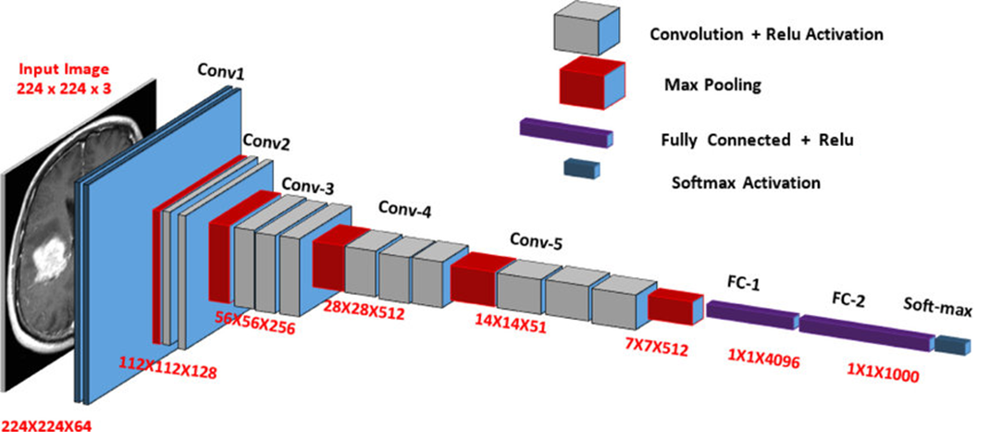
VGG-16

Slide 20
References
Z. Zuo, B. Shuai, G. Wang, X. Liu, X. Wang, B. Wang, and Y. Chen, “Learning contextual dependence with convolutional hierarchical recurrent neural networks,” IEEE Transactions on Image Processing, vol. 25, no. 7, pp. 2983–2996, 2016.
W. Rawat and Z. Wang, “Deep convolutional neural networks for image classification: A comprehensive review,” Neural computation, vol. 29, no. 9, pp. 2352–2449, 2017.
N. Aloysius and M. Geetha, “A review on deep convolutional neural networks,” in 2017 international conference on communication and signal processing (ICCSP). IEEE, 2017, pp. 0588–0592.

Slide 21


